Slide 1


EICT 2021 5th International Conference on Electrical Information and Communication Technology
Design and FEM Analysis of a Novel Steering Shaped Photonic Crystal Fiber
Mohammad Asif Arefin, Md Kabirul Islam Department of Mathematics, Jashore University of Science and Technology Department of Multimedia and Creative Technology, Daffodil International University (DIU)
Paper ID- 146
Novel Steering shape PCF
1

Slide 2
EICT 2021
5th International Conference on Electrical Information and Communication Technology
OUTLINE
Introduction
Objectives
Literature Review
Proposed Design
Simulation and Results
Comparison Table
Conclusion
References
Paper ID-146
2

Slide 3
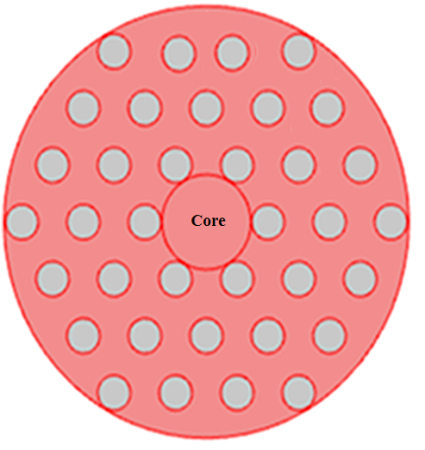
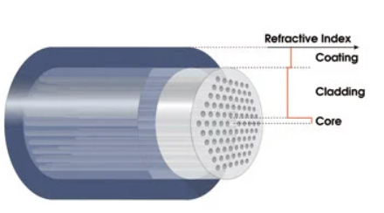
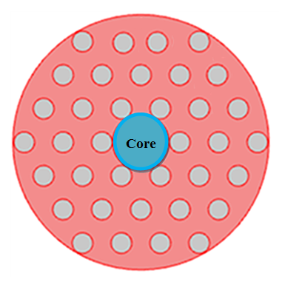
EICT 2021
5th International Conference on Electrical Information and Communication Technology
INTRODUCTION
Solid core
Solid-core PCF
Holey cladding
Guide light by TIR
n_{core} > n_{cladding}
PBG-Guiding PCF
Hollow core
Guide light by PBG
n_{core} < n_{cladding}
Figure 1. Structure of PCF
Figure 2 : Different types of PCF
Paper ID-146
3
3

Slide 4
EICT 2021
5th International Conference on Electrical Information and Communication Technology
OBJECTIVES
To design simple structure with high performance that reduces the
complexity of fabrication process.
To design and characterization of photonic crystal fiber for nonlinear application.
To achieve high birefringence.
Paper ID-146
4

Slide 5
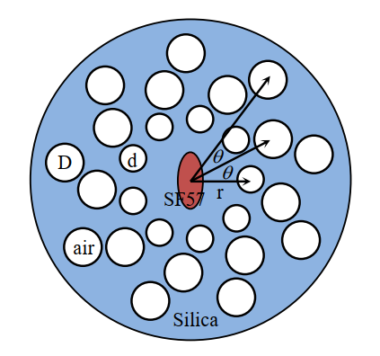
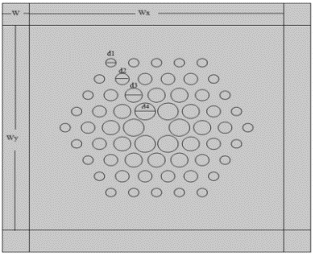
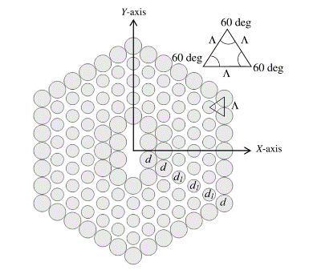
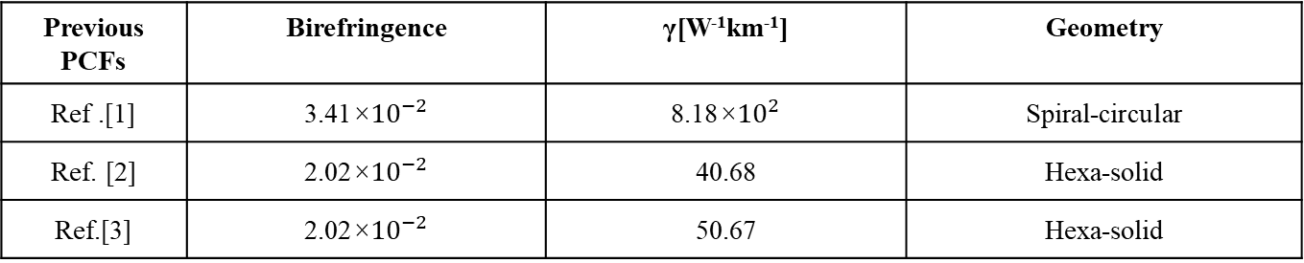
EICT 2021
5th International Conference on Electrical Information and Communication Technology
LITERATURE REVIEW
Ref. [1]
Ref. [2]
Ref. [3]
Previous PCFs | Birefringence | γ[W⁻¹km⁻¹] | Geometry
Ref .[1] | 3.41×${10}^{−2}$ | 8.18×${10}^{2}$ | Spiral-circular
Ref. [2] | 2.02×${10}^{−2}$ | 40.68 | Hexa-solid
Ref.[3] | 2.02×${10}^{−2}$ | 50.67 | Hexa-solid
Ref. [1] J Liao, T Huang, Z Xiong, F Kuang, and Y Xie, “Design and analysis of an ultrahigh birefringent nonlinear spiral photonic crystal fiber with large negative flattened dispersion, Optik, vol. 135, pp.42-49, 2017.
Ref. [2] P A Agbemabiese, and E K Akowuah, “Numerical analysis of photonic crystal fiber of ultra-high birefringence and high nonlinearity,” Scientific Reports, vol. 10(1), pp.1-12, 2020.
Ref. [3] M R Hasan, M S Anower, and M I Hasan, “Polarization maintaining highly nonlinear photonic crystal fiber with closely lying two zero dispersion wavelengths,” Optical Engineering, vol. 55, p.056107, 2016.
Paper ID-146
5

Slide 6
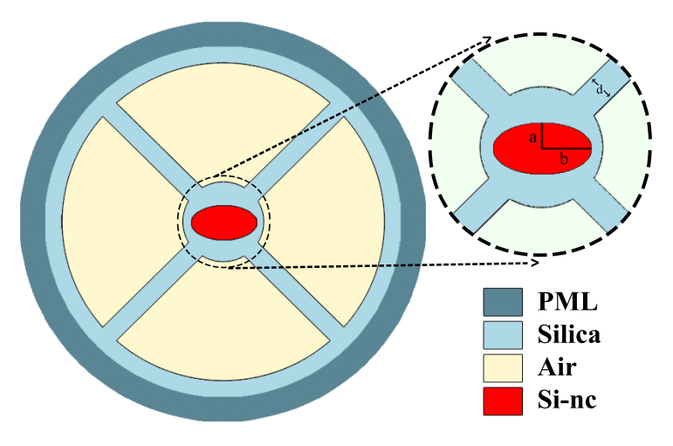
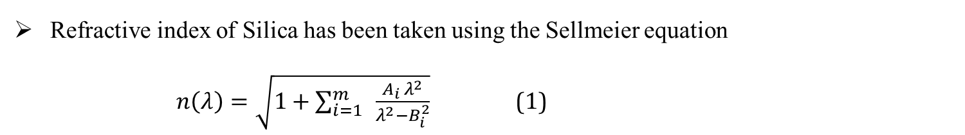
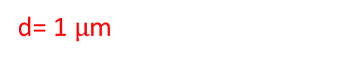
EICT 2021
5th International Conference on Electrical Information and Communication Technology
PROPOSED DESIGN
d= 1 $µ$m
Figure 3. Crossed section of the proposed PCF.
Refractive index of Silica has been taken using the Sellmeier equation
$n\left(λ\right)=\sqrt{1+\sum_{i=1 }^{m}{ \frac{A_{i }λ^{2}}{λ^{2}−B_{i}^{2}}}}$ (1)
Paper ID-146
6

Slide 7
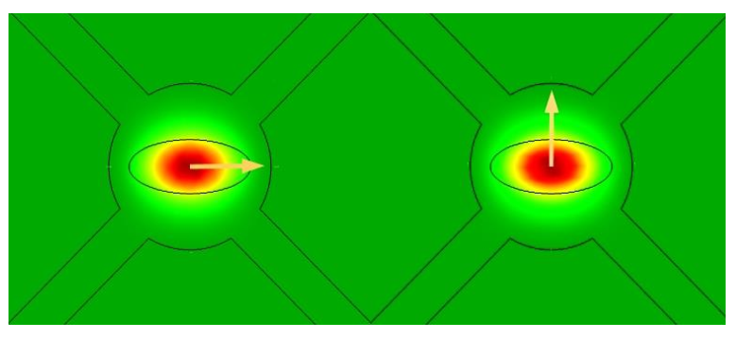
EICT 2021
5th International Conference on Electrical Information and Communication Technology
SIMULATION AND RESULTS
Fig. 4 Intensity profile of fundamental guided mode For X and Y polarization.
Paper ID-146
7

Slide 8
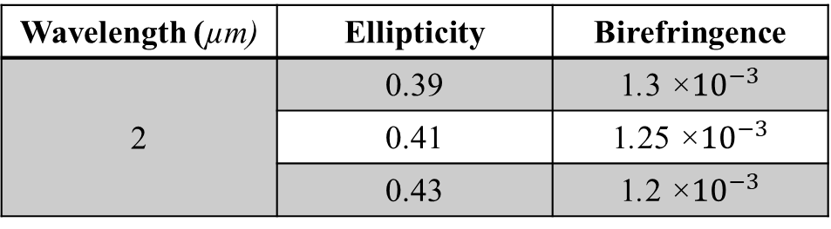
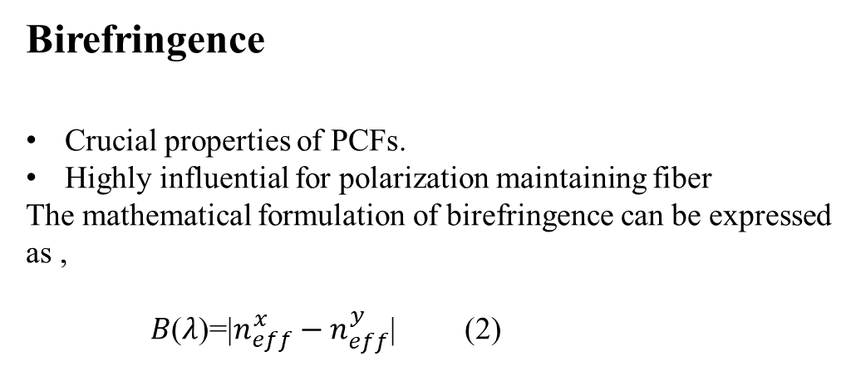
EICT 2021
5th International Conference on Electrical Information and Communication Technology
SIMULATION AND RESULTS cont.
Birefringence
Crucial properties of PCFs.
Highly influential for polarization maintaining fiber
The mathematical formulation of birefringence can be expressed as ,
𝐵(𝜆)=|$n_{eff}^{x}−n_{eff}^{y}$| (2)
Wavelength (µm) | Ellipticity | Birefringence
2 | 0.39 | 1.3 ×${10}^{−3}$
 | 0.41 | 1.25 ×${10}^{−3}$
 | 0.43 | 1.2 ×${10}^{−3}$
Fig. 5: Birefringece vs. wavelength profile
Paper ID-146
8

Slide 9
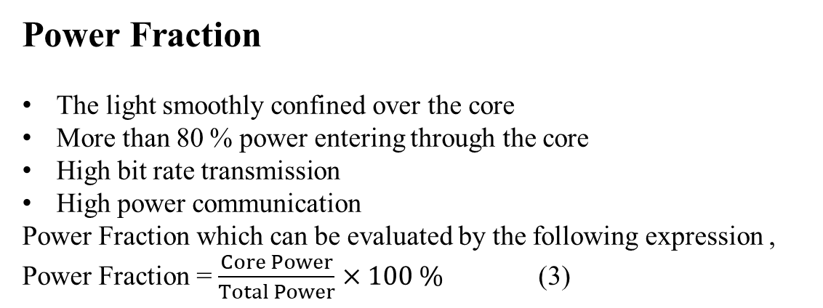
EICT 2021
5th International Conference on Electrical Information and Communication Technology
SIMULATION AND RESULTS cont.
Power Fraction
The light smoothly confined over the core
More than 80 % power entering through the core
High bit rate transmission
High power communication
Power Fraction which can be evaluated by the following expression ,
Power Fraction = $\frac{Core Power}{Total Power}$ $×100 \%$ (3)
Fig. 6: Power Fraction vs. wavelength profile
Paper ID-146
9

Slide 10
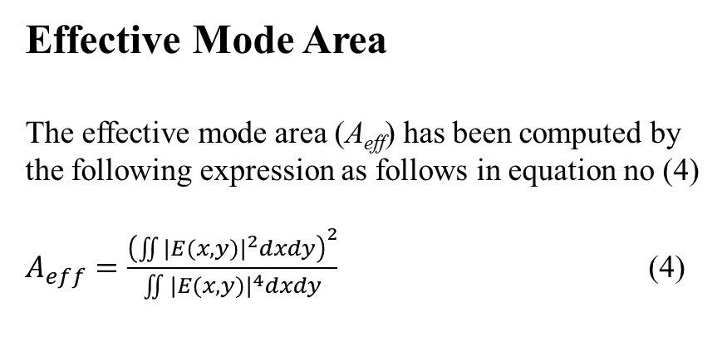
EICT 2021
5th International Conference on Electrical Information and Communication Technology
SIMULATION AND RESULTS cont.
Effective Mode Area
The effective mode area (A_{eff}) has been computed by the following expression as follows in equation no (4)
$A_{eff}=\frac{{\left(\iint{{|E(x,y)|}^{2}dxdy}\right)}^{2}}{\iint{{|E(x,y)|}^{4}dxdy}}$ (4)
Fig. 7 Wavelength vs Effective mode area
Paper ID-146
10

Slide 11
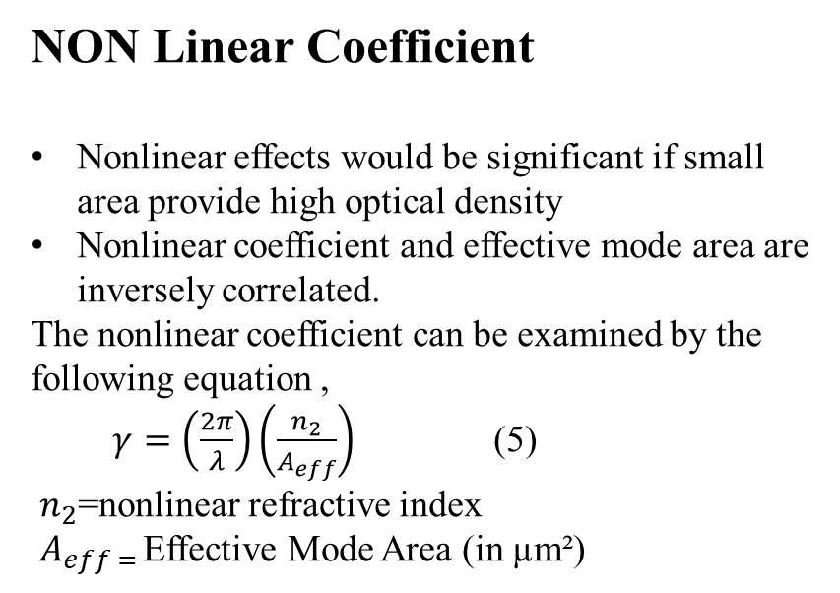
EICT 2021
5th International Conference on Electrical Information and Communication Technology
SIMULATION AND RESULTS cont.
NON Linear Coefficient
Nonlinear effects would be significant if small area provide high optical density
Nonlinear coefficient and effective mode area are inversely correlated.
The nonlinear coefficient can be examined by the following equation ,
$γ=\left(\frac{2π}{λ}\right)\left(\frac{n_{2}}{A_{eff}}\right)$ (5)
$n_{2}$=nonlinear refractive index
$A_{eff = }$Effective Mode Area (in µm²)
Fig.8 Wavelength vs Non linear coefficient
Paper ID-146
11

Slide 12
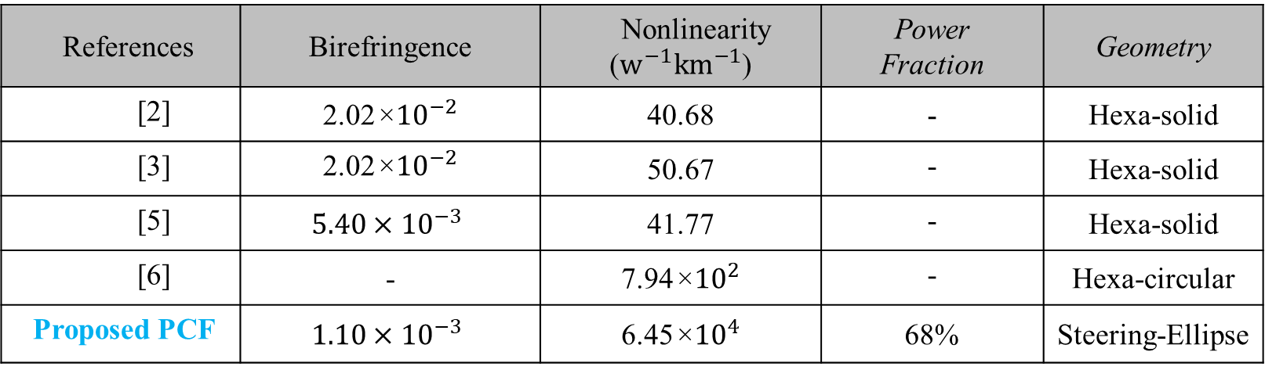
EICT 2021
5th International Conference on Electrical Information and Communication Technology
Comparison Chart With Prior Work
References | Birefringence | Nonlinearity ($w^{−1}km^{−1}$) | Power Fraction | Geometry
[2] | 2.02×${10}^{−2}$ | 40.68 | - | Hexa-solid
[3] | 2.02×${10}^{−2}$ | 50.67 | - | Hexa-solid
[5] | $$5.40×{10}^{−3}$$ | 41.77 | - | Hexa-solid
[6] | - | 7.94×${10}^{2}$ | - | Hexa-circular
Proposed PCF | $$1.10×{10}^{−3}$$ | 6.45×${10}^{4}$ | 68% | Steering-Ellipse
Paper ID-146
12

Slide 13
EICT 2021
5th International Conference on Electrical Information and Communication Technology
Application of proposed PCF
The proposed PCF may be a good applicant for
Super continuum Generation
Parametric Amplification
Four Wave Mixing
Optical Communication
Fiber Sensors
Optic Coherence Tomography (OCT)
Paper ID-146
13

Slide 14
EICT 2021
5th International Conference on Electrical Information and Communication Technology
REFERENCES
[1]. J Liao, T Huang, Z Xiong, F Kuang, and Y Xie, “Design and analysis of an ultrahigh birefringent nonlinear spiral photonic crystal fiber with large negative flattened dispersion, Optik, vol. 135, pp.42-49, 2017.
[2]. P A Agbemabiese, and E K Akowuah, “Numerical analysis of photonic crystal fiber of ultra-high birefringence and high nonlinearity,” Scientific Reports, vol. 10(1), pp.1-12, 2020.
[3]. M R Hasan, M S Anower, and M I Hasan, “Polarization maintaining highly nonlinear photonic crystal fiber with closely lying two zero dispersion wavelengths,” Optical Engineering, vol. 55, p.056107, 2016.
[4]. R Saha, M M Hossain, M E Rahaman, “Design and analysis of high birefringence and nonlinearity with small confinement loss photonic crystal fiber,” Frontiers of Optoelectronics, vol. 12(2), pp.165-173, 2019.
[5] Agbemabiese, P Atsu, and E K Akowuah. “Numerical analysis of photonic crystal fibre with high birefringence and high nonlinearity.” Journal of Optical Communications, 2020.
[6] Y E Monfared, and S A Ponomarenko, “Extremely nonlinear carbondisulfide-filled photonic crystal fiber with controllable dispersion,” Optical Materials, vol.88, pp.406-411, 2019.
Paper ID-146
14

Slide 15
EICT 2021
5th International Conference on Electrical Information and Communication Technology
Thank you all for your kind attention.
Welcome to Q & A session!!!
Paper ID-146
15

